Slide 1


GROUP III - MARKET MOVERS
Factors Influencing House Prices:
A Regression Analysis
Adharsh Sundaram Soudakar, Aishuang Lin, Ashan M S S W , Cecilia Chang, Ellie Leadbetter

Slide 2

Business Problem
A real estate agent seeks to understand the factors influencing house prices in California to enhance their ability to provide accurate price estimates for clients' properties.
Specifically, they are interested in how location, house age, number of rooms per block, block density, number of households per block, household income, area population and proximity to the ocean affect house prices across the state.
Null Hypothesis (H₀): "Collectively, the selected factors do not significantly affect house prices in California" (p≥0.05)
Alternative Hypothesis (H₁): "Collectively, the selected factors do significantly affect house prices in California" (p<0.05)
Notes:
The housing market is highly unstable and dependent on moves in supply and demand, as well as economic factors like interest rates and inflation. This volatility makes predicting price variations over time particularly challenging.
real estate:

Slide 3
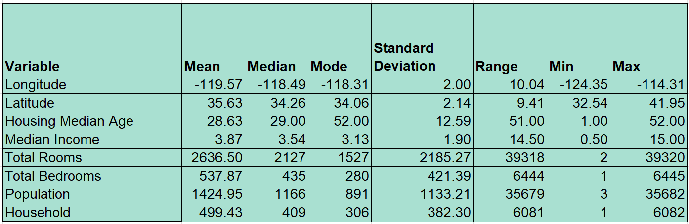
Explanatory Variables
In this sample a block group on average has 1425.5 people.

Slide 4
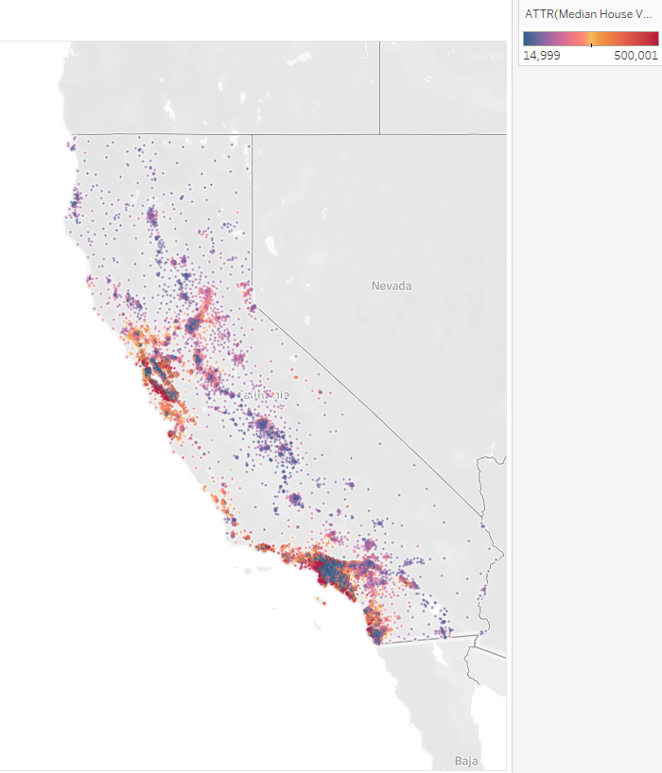
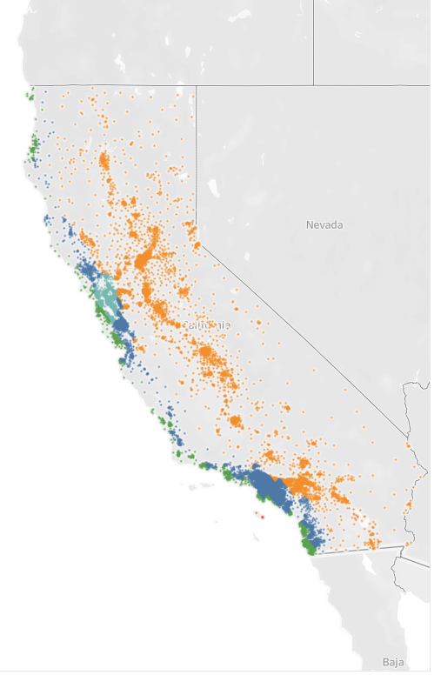

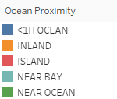
Descriptive analytics
From the sample, it is evident that coastal properties are more expensive (San Francisco, Bay Area, Los Angeles and Silicon Valley)
House prices decrease as property locations move inland and further north.
In the second plot, Inland houses are the most common observation.
Island homes are very limited (5), shown in red.
Median House Value (GEO)
House dist. WRT OCP (GEO)
Data source: California housing Price
Notes:
For our analysis, we used data on house prices across California. The data includes variables like median income, proximity to the ocean, and house age, all key predictors in our model.

Slide 5
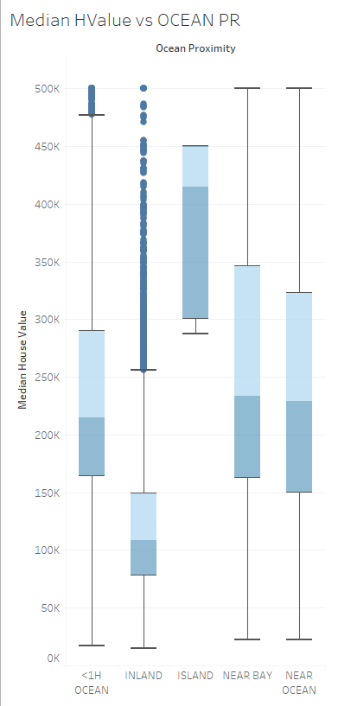
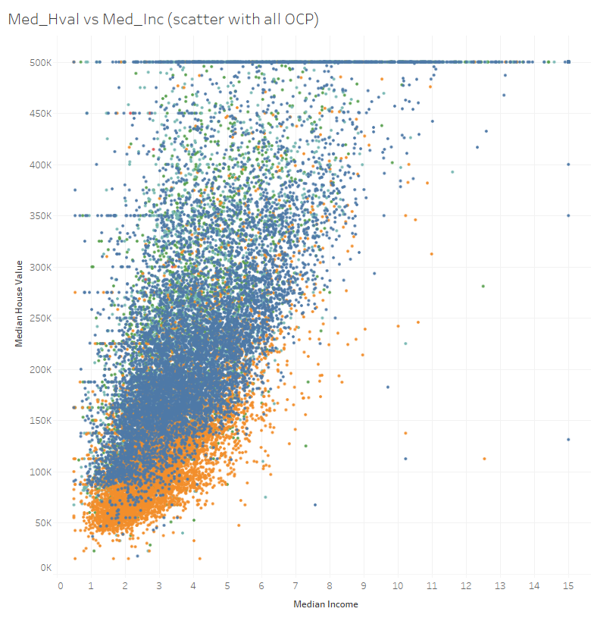
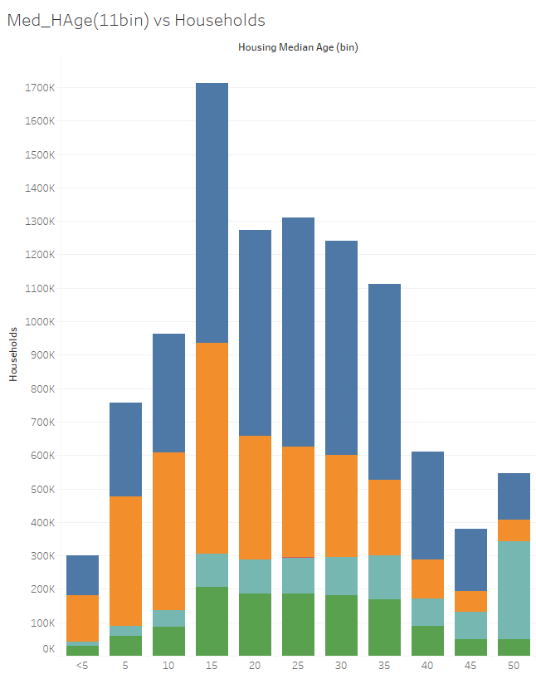
Descriptive analytics
Plot 1 - Each box represents the interquartile range (IQR) and it can be seen that units near the ocean have a wider range of values, reflecting diverse pricing options.
Plot 2 - There is a strong positive relationship between median income and median house value, better earners invest in pricier houses.
Plot 3 - Newer houses are most common ‘Inland’, indicating recent developments compared to coastal regions. Most older houses are found in the ‘Bay Area’ and there is a trend highlighting a shift in development focus from costal areas to inland regions over time.
HL Med. House Value WRT OCP
Median House Value vs Median Income
Median House Age (bins) vs Households
Data source: California housing Price
Notes:
DFor our analysis, we used data on house prices across California. The data includes variables like median income, proximity to the ocean, and house age, all key predictors in our model.
Graph 1 shows the Median house price change based on the geographical location.
Graph 2 is a box plot that shows the distribution of median house values for different categories based on their proximity to the ocean. <1H OCEAN: Houses in this category have the highest median values, with a relatively concentrated distribution.
INLAND: Houses here have the lowest median values, with a more dispersed distribution.
ISLAND and NEAR BAY: These categories have relatively high median values, but with a wider range of distribution.
NEAR OCEAN: Houses have high median values.
Graph 3 visually represent how housing values vary with respect to both income levels and proximity to the ocean, indicating that both factors might significantly influence real estate prices. (showing relationship between median income and house price separately for ocean proximity categories, so shows that median house value and median income is SIMILAR across those categories).

Slide 6

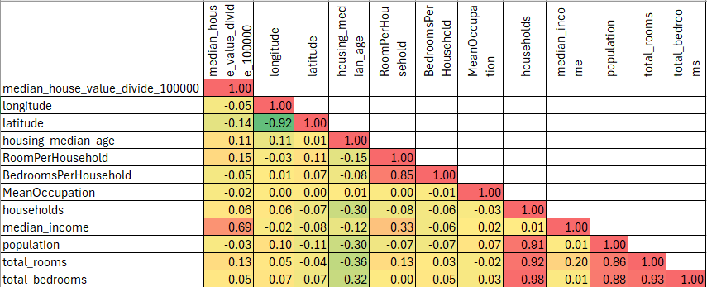
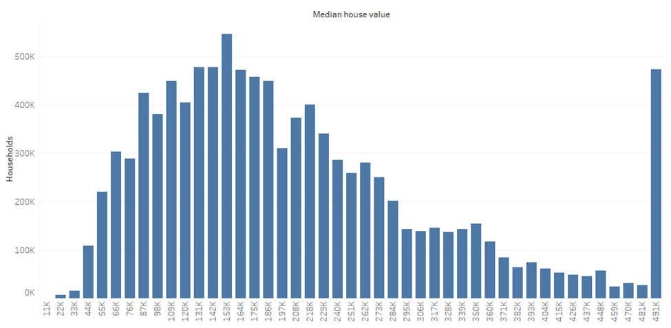
Descriptive analytics
Median Income is the best numerical predictor (positively correlated) of Median House Value.
Four highly intra-correlated features can be observed which will cause multicollinearity when performing regression analysis.
To mitigate multicollinearity issue, three new features namely ‘Rooms per household’, ‘Bedrooms per household’ and ‘Mean occupation’ were created.
Median House value ranges from 14,999 to 500,001
The distribution is slightly shifted to the left with a long tail.
However, a normal distribution can be observed around the peak (153k) as the median.
A noticeable spike at the end indicates a cap on the feature (Winsorizing).
Correlation Matrix
Median House Value Distribution
Notes:
The residual plot helps assess the linearity assumption.
This plot assesses the constant variance (homoscedasticity) assumption.
This histogram shows the distribution of residuals and helps further check normality.
This plot helps check if the residuals follow a normal distribution. This indicates that the residuals are not normally distributed, especially for extreme values (outliers)
Q-Q Plot Analysis:
In the Q-Q plot, the points deviate significantly from the straight line, particularly at both the lower and upper ends (tails). This indicates that the residuals are not normally distributed, especially for extreme values (outliers).
Residuals vs. Fitted Values (Homoscedasticity Check):
This means that the variance of the residuals is not constant across all predicted values—larger fitted values tend to have more dispersed residuals, suggesting that predictions for higher-priced homes are more uncertain.

Slide 7
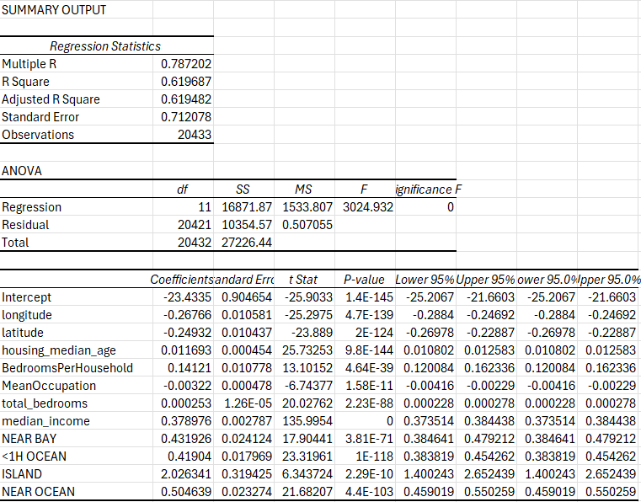

Regression Model
The regression analysis yielded a fairly strong model which explains 62% of the variance in house price.
The high F-stat and low p-values confirm the statistical significance of the features in consideration, assuring a reliable house price prediction.
Geographical location (LAT LONG), Ocean Proximity, median income and Bedrooms per household are the strongest predictors.
The negative coefficients of the geographical location indicate that as we move further south (and/or) east, houses’ value will decrease.
Median income has the highest positive impact, proving our initial analysis correct.
Older properties with more rooms/bedrooms per household will increase in value.
Notes:
We applied a multiple regression model to test our hypothesis. The goal was to see how well these variables explain the variation in housing prices across California. The model accounts for multicollinearity and tests for linear relationships.
Model 1: The regression analysis indicates a moderately strong model (R2 = 0.647), with significant predictors of house value including geographical location (longitude, latitude), housing median age, number of bedrooms, population, and median income. Negative coefficients for proximity to regions like NEAR BAY and <1H OCEAN suggest lower house values in these areas. The low p -values (< 0.05) for most variables confirm their statistical significance. The overall model is significant (F-statistic: 2883.995), implying it reliably predicts house values. In conclusion, factors like income, geography, and housing characteristics substantially impact house values, with the model explaining about 64.7% of the variance.
Model 2 indicates that 62.2% of the variance in house values is explained by the predictors. Significant variables include geographical factors (longitude, latitude), housing median age, number of bedrooms, and median income, all with p-values below 0.05. The model suggests that house values decrease with proximity to regions like NEAR BAY and <1H OCEAN. The F-statistic confirms the model's overall significance. In conclusion, geography, income, and housing characteristics significantly influence house values, with the model effectively capturing key factors affecting housing prices.
Optimum model
Based on the R2, Adjusted R2, standard error, and F-statistic, Model 1 is statistically superior to Model 2. It explains a greater proportion of the variance, has more precise predictions, and a slightly stronger overall relationship between the variables. Therefore, Model 1 is the recommended model for predicting house values.

Slide 8
Findings
01.
02.
03.
The Null Hypothesis is rejected.
The P value is less than 0.5 and has a high F Value of 3025.
62% of the variation in Median House price can be predicted from the given variables.
Median Income (shown in $10,000 USD) an increase in 1 unit in median income which is equal to 10,000 in income is associated with an increase in median house price of .378 or $38,000 USD (as house price is in $100,000)
Limitations of the Model:
High multicollinearity
Truncation restricts extrapolation into values above the median house price of $500,000.
Notes:
Limitations & Uncertainty:
Both models faced challenges: the standard errors were somewhat inflated due to multicollinearity, which introduces uncertainty about the precise impact of individual predictors. The variance of residuals varied across the data, indicating that the models may struggle to predict extreme values.
Implications for Decision-Making:
Given the uncertainty in the results, real estate agents should exercise caution when making precise price predictions, especially in areas with less typical housing characteristics.
Further refinement of the models and additional data on market trends or economic factors could enhance prediction accuracy.

Slide 9

Suggestions/Decisions
01.
The truncation of the data limits the accuracy of extrapolating above $500,000 in house price. Access to the raw census data or further data collection of a larger price range would increase the efficiency of the model.
02.
The limitation of multicollinearity. This could be improved by removing the ‘dummy’ variables added when creating the model. Latitude and longitude are carrying similar information but also give individual information, so can account for a high level of multicollinearity in our model.
03.
62% of the variability in median house price can be explained by the selected characteristics, so by adding more predictors the model such as proximity to schooling, community service or crime rates would allow even more accurate predictions.
Notes:
To Real estate agents, they can offer more precise valuations and better serve their clients based on proximity to the ocean, household income, and location.Newer homes near the ocean, in wealthier areas, tend to have higher price premiums.

Slide 10

Conclusion and Recommendations
The Real Estate Agent can use the factors of location, house age, number of rooms per block, block density, number of households per block, household income, area population and proximity to the ocean can be used to predict house prices for customers.
Encourage adding more-readily available measure to refine the model and improve estimations for customers as there are limitations of time in collection of census data.

